Slide 1
Marketing 101 for Beginners
Notes:
Disclaimer: All pictures are shamelessly copied from the internet.

Slide 2
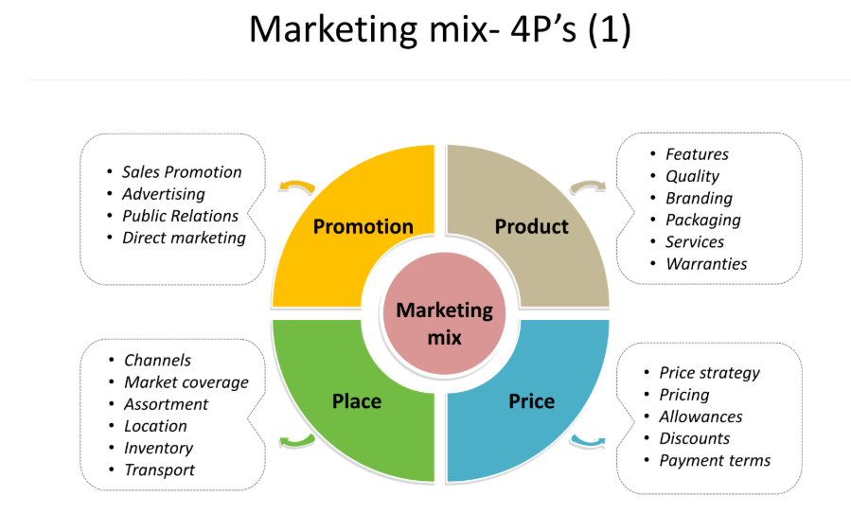
Recap: Marketing mix - The 4Ps of Marketing

Slide 3
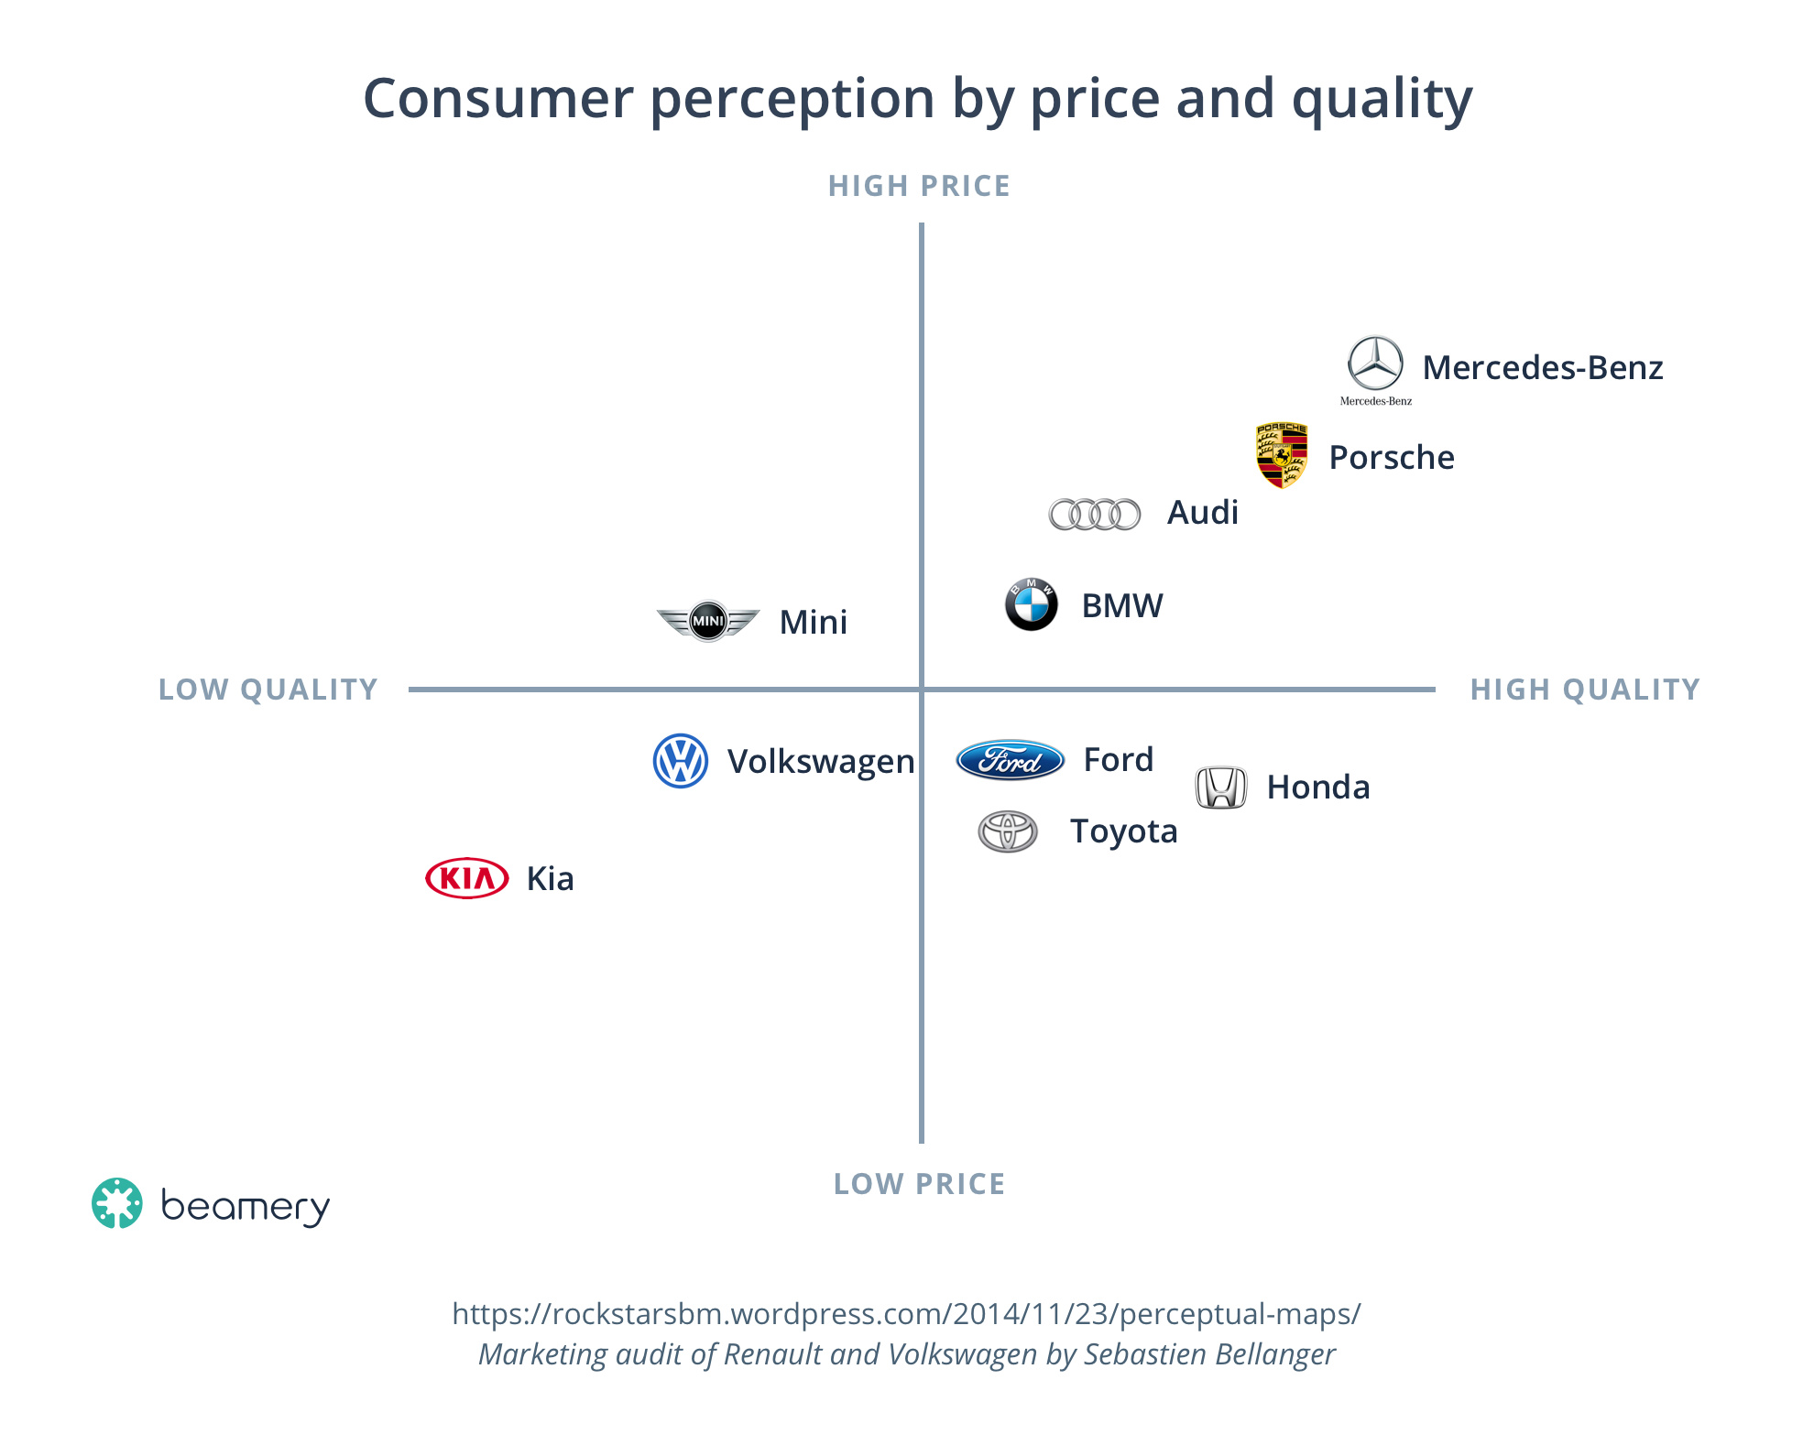
Positioning map of cars

Slide 4
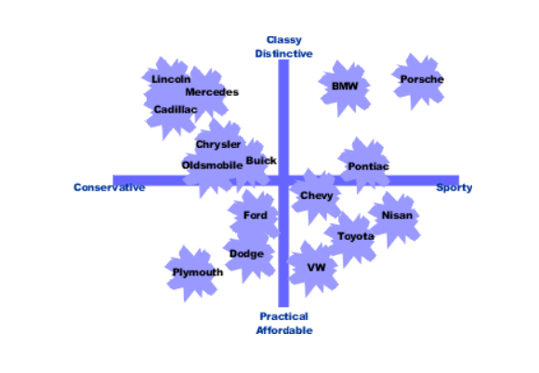
Positioning map of cars

Slide 5
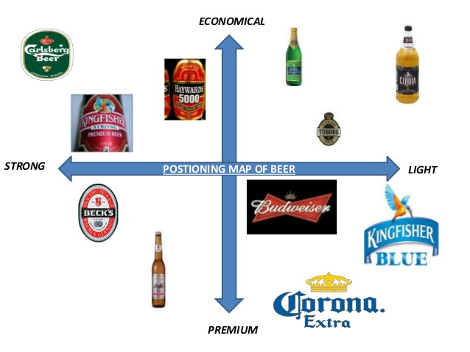
Positioning map of beer brands

Slide 6
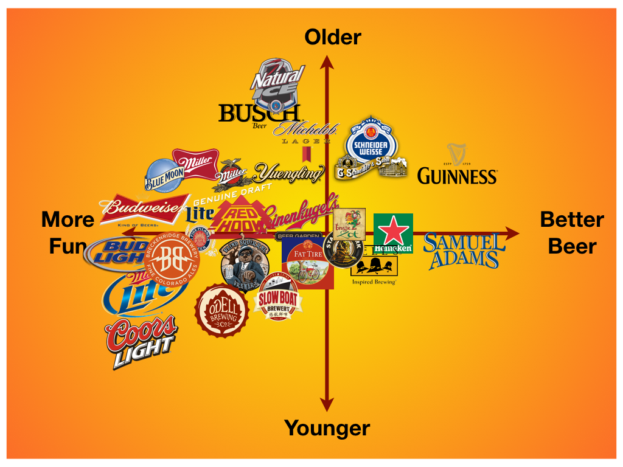
Positioning map of beer brands

Slide 7
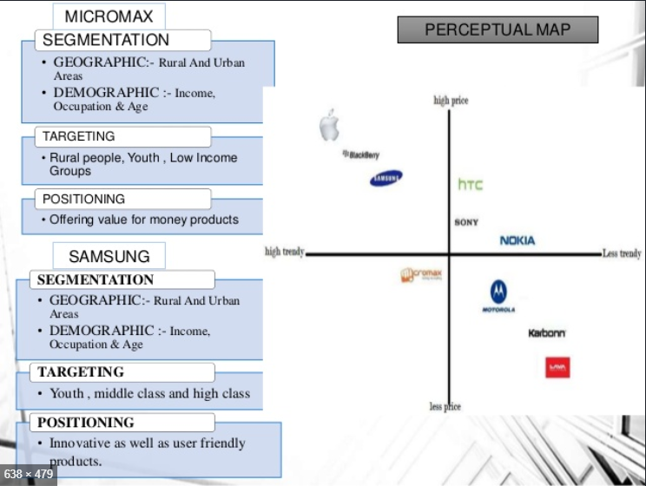
Positioning map of Micromax and Samsung

Slide 8
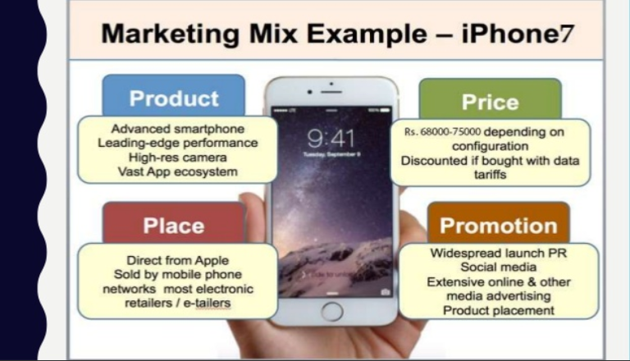
Positioning of an iPhone 7 - example

Slide 9
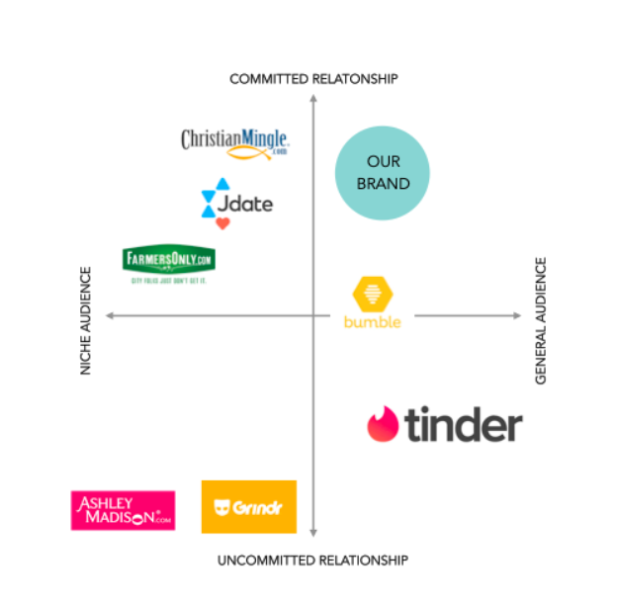
STP is useful for all customer needs!

Slide 10
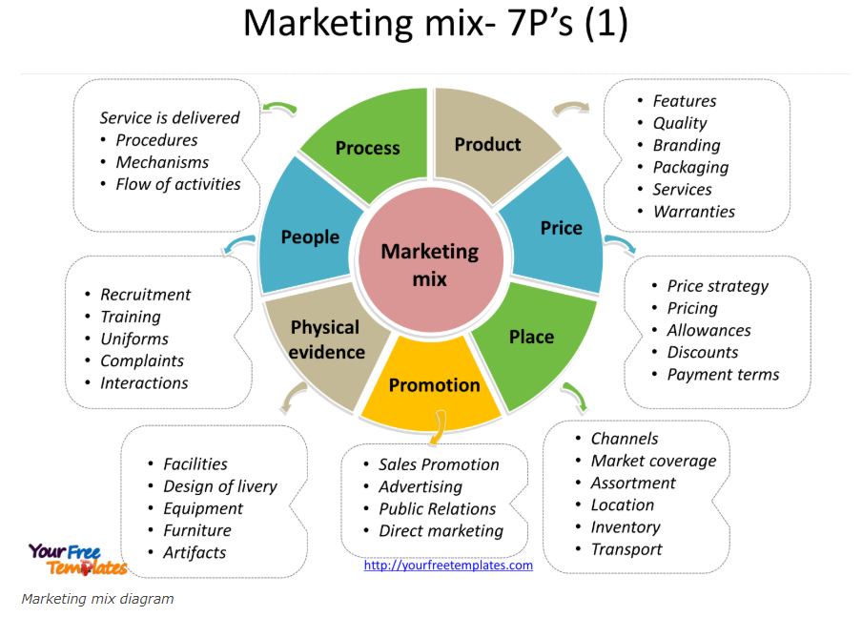
Marketing Mix for Services – The 7Ps of Marketing

Slide 11

Assignment time

Slide 12
Open book assignment
Product launch of Copper Sulphate (commercial) / PVP (Povidone)
Marketing campaign for ICT / Manzar
Hint: Use 7Ps for ICT / Manzar

Slide 13


MARKETING
Marketing:
Some misconceptions
Marketing and Sales
Customer base
© ULTRA CONSERVE PVT. LTD.

Slide 14
MARKETING
What is Marketing?:
Why is marketing needed?
© ULTRA CONSERVE PVT. LTD.

Slide 15
MARKETING
Misconception 1: Marketing is for people who like to talk and talk and talk…
Place for genuine character and genuine efforts
Misconception 2: Marketing is for people who don’t like the technical stuff…
Marketing is for people with passion or purpose
© ULTRA CONSERVE PVT. LTD.

Slide 16
MARKETING
Misconception 3: Marketing people don’t do much…
True that marketing has relatively less reporting tasks and more measure of freedom, nature of work is less clearly defined and hence your goals are that much more daunting
© ULTRA CONSERVE PVT. LTD.

Slide 17
MARKETING
Difference between Sales and Marketing:
Air force-army example, P&G vs ITC example, Cong vs BJP example
© ULTRA CONSERVE PVT. LTD.

Slide 18
MARKETING
Categories of marketing: B2B vs B2C vs B2I
Examples of each
© ULTRA CONSERVE PVT. LTD.

Slide 19
MARKETING
Plans for Marketing:
Immediate (Upto 3 Months): Operational market share improvement plans in a region or product
Short term (1 year): Tactical plans to dominate a category or segment
Long term (3-5 years): Strategic positioning, brand launch plans, etc.
Plan should include tonnages as well as revenues & budgets
© ULTRA CONSERVE PVT. LTD.

Slide 20
MARKETING
Inputs :
Production plan
Product information / produces
Pricing Guidelines
Customer details
Outputs:
Marketing plan
Review addition of customers
Increase in sales , revenue
© ULTRA CONSERVE PVT. LTD.

Slide 21
MARKETING
Information:
Products & Services
Uses
Specifications
Availability
Packaging
Regulatory issues
© ULTRA CONSERVE PVT. LTD.

Slide 22
MARKETING
Customers & Competitor
Know your customers
Policies
Difficulties
Requirements
Competitor
Products
Pricing
Strength & weakness
Practices.
© ULTRA CONSERVE PVT. LTD.

Slide 23
MARKETING
Information Gathering:
Library best source
Trade fares
Internal meetings
Academic institutions
Develop own networking
© ULTRA CONSERVE PVT. LTD.

Slide 24
MARKETING
Creating Marketing Plans:
STP
© ULTRA CONSERVE PVT. LTD.

Slide 25
MARKETING
Creating Marketing Plans:
4P’s and 7P’s of Marketing (include pricing slide)
© ULTRA CONSERVE PVT. LTD.

Slide 26
MARKETING
Pricing:
Based on
Opportunity
Cost Based
Distress sale
© ULTRA CONSERVE PVT. LTD.

Slide 27
MARKETING
Interactions:
R & D for new products
Operations for plans/stocks
Sales for logistics
© ULTRA CONSERVE PVT. LTD.

Slide 28
MARKETING
Remember
You are
Face of the company
Control your Budget & overheads
Do not show off
Do not underwrite other Depts./personal
© ULTRA CONSERVE PVT. LTD.

